Slide 1

CAREERS IN DATA
Shekhar
Dallas
Meagan

Slide 2
Motivation
Why are we in this class?
In this project, we aimed to discover what it takes to get a foot in the industry, where the opportunities lie, and the level of satisfaction in this burgeoning field.

Slide 3
Questions
Shekhar
Which location/region has the most opportunities?
What's the difference between data scientist, data engineer and data analyst?
Can you develop an efficient classification algorithm to differentiate the three job types above?

Slide 4
Exploration
Shekhar
Refered Kaggle Data Science DataSet
Google Api.
Word Cloud.
Wikipedia package.
Bokeh Geomap library.
Linear Regregreesion from sklearn

Slide 5
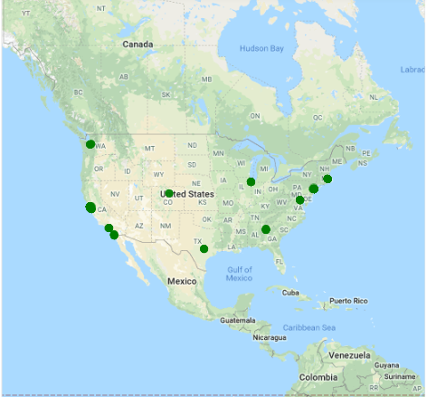
Analysis
Shekhar

Slide 6
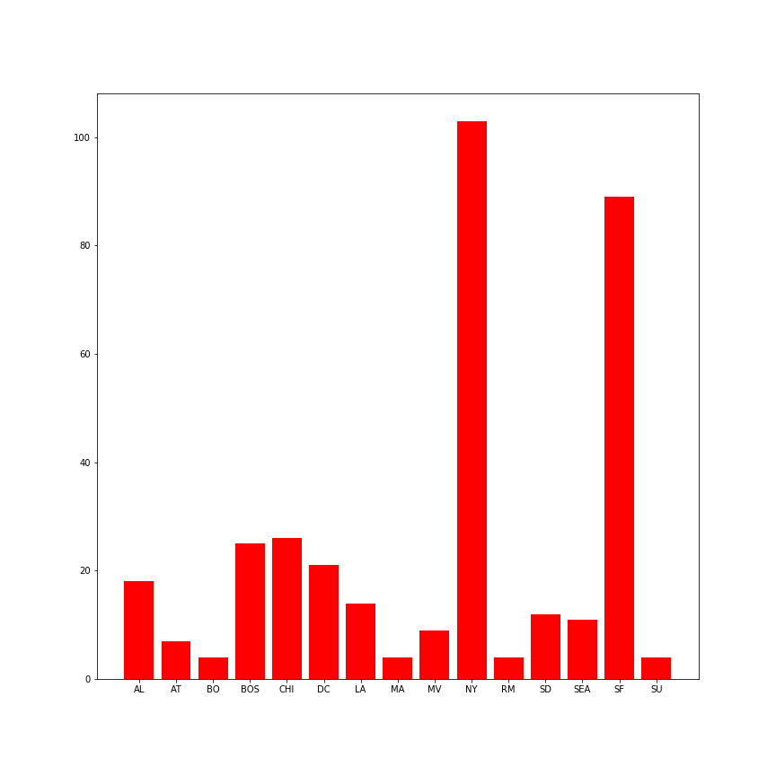
Analysis
Shekhar

Slide 7
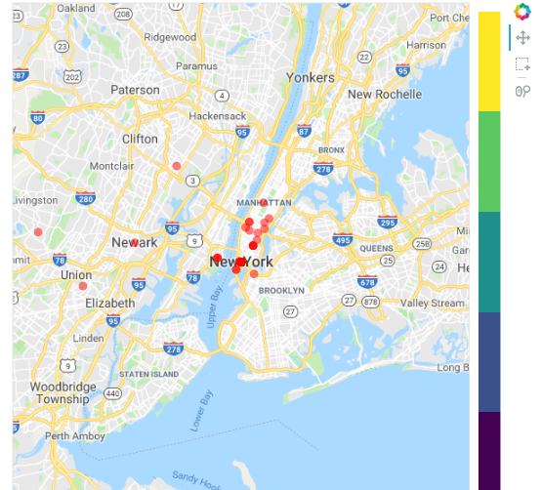
Analysis
Shekhar

Slide 8
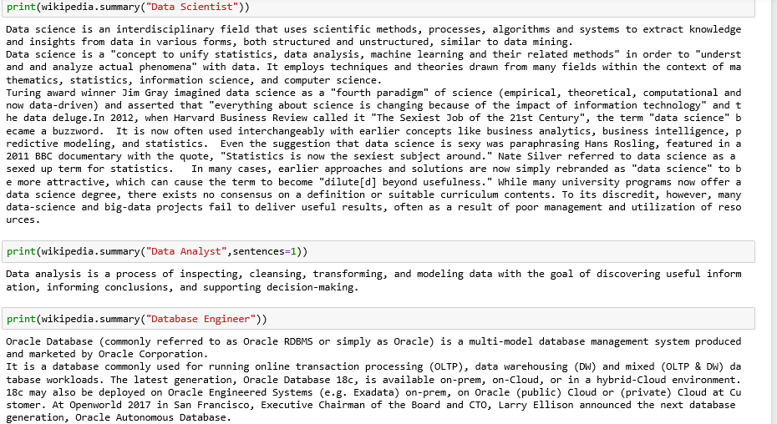
Analysis
Shekhar

Slide 9
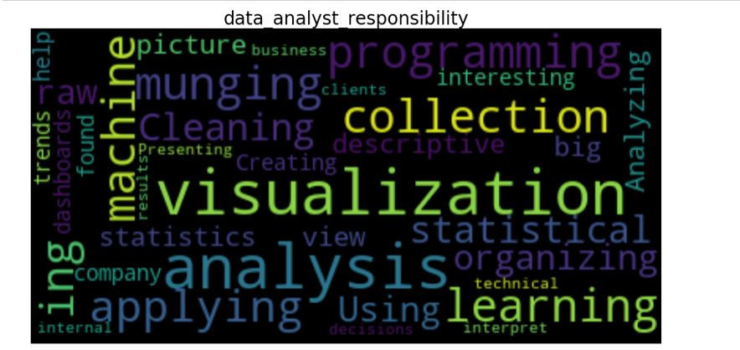
Analysis
Shekhar

Slide 10
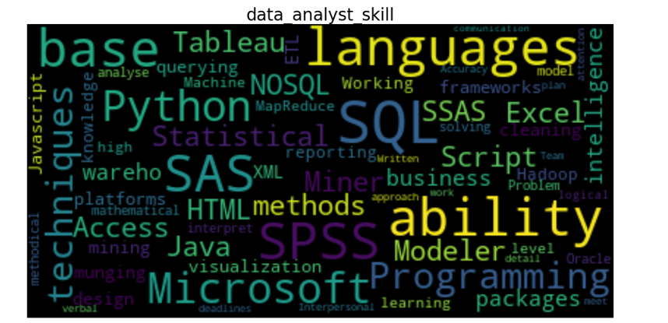
Analysis
Shekhar

Slide 11
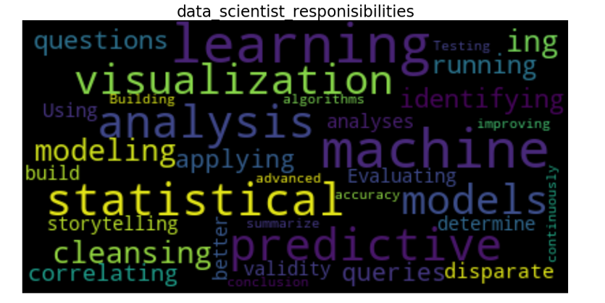
Analysis
Shekhar

Slide 12
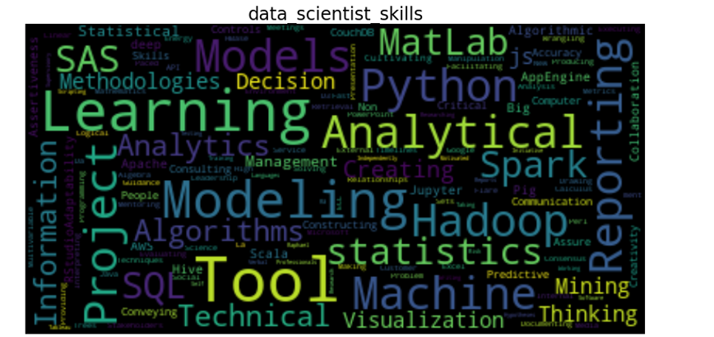
Analysis
Shekhar

Slide 13
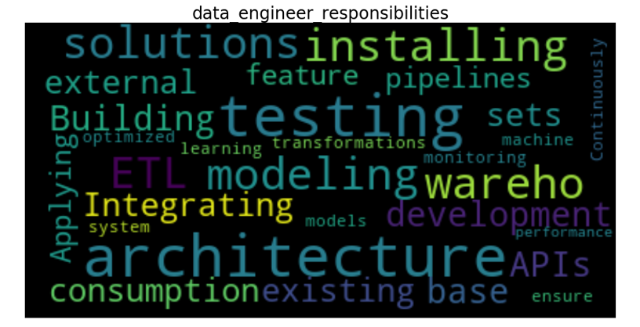
Analysis
Shekhar

Slide 14
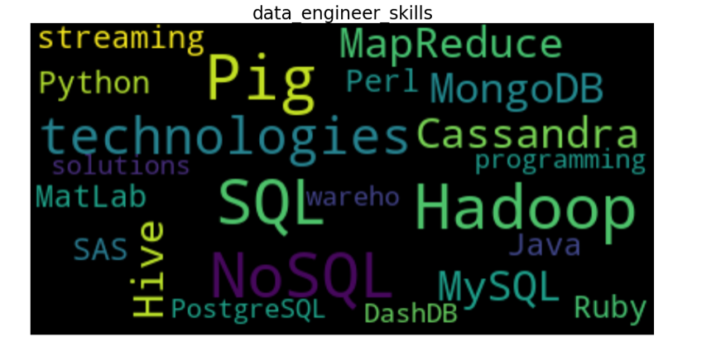
Analysis
Shekhar

Slide 15
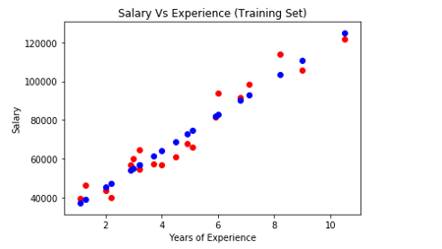
Analysis
Shekhar

Slide 16
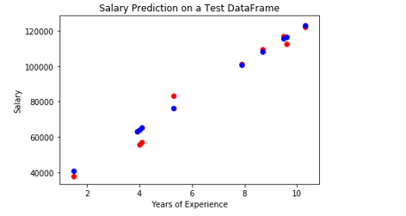
Analysis
Shekhar

Slide 17
Questions
Meagan
Who gets hired? What kind of talent do employers want when they are hiring a data scientist?
Which programming languages are most used in data science?
What are trends in salary and market growth?

Slide 18
Exploration
Meagan
Kaggle Dataset – Indeed US Jobs Scraper 2018
Stack Overflow Survey 2018 Dataset
Bureau of Labor Statistics Occupational Employment Survey 2017 Dataset

Slide 19
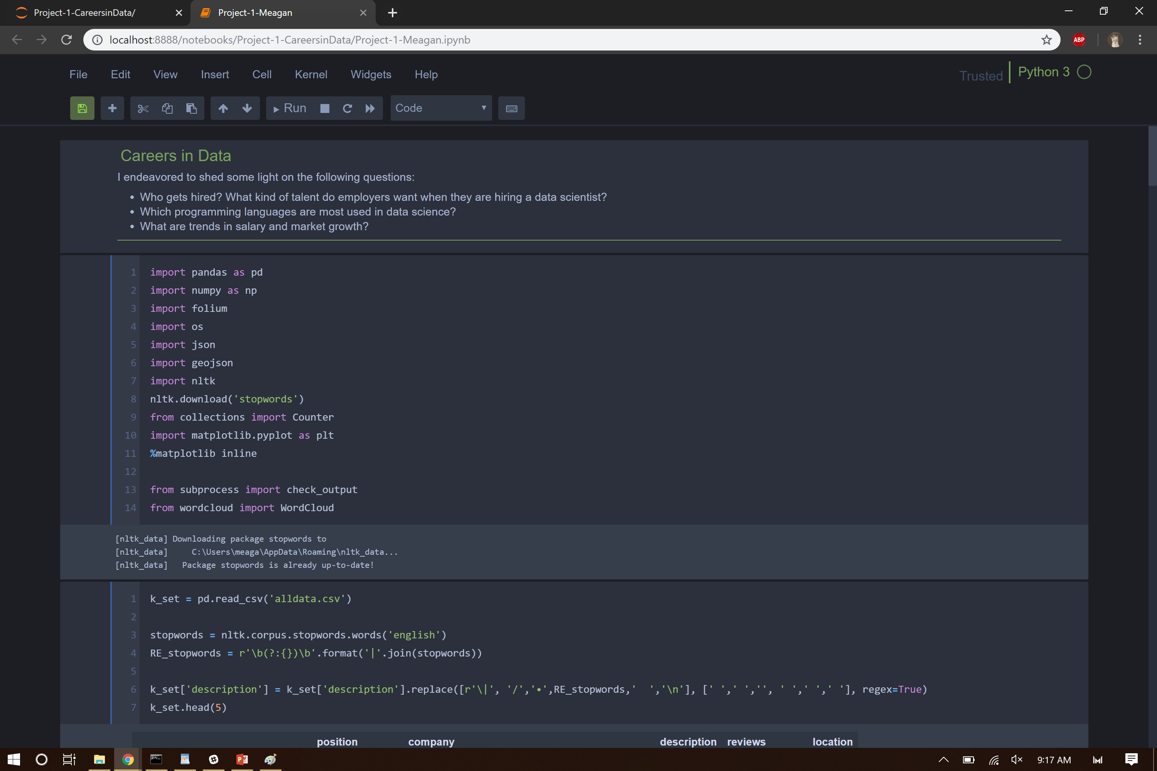
Analysis
Meagan

Slide 20
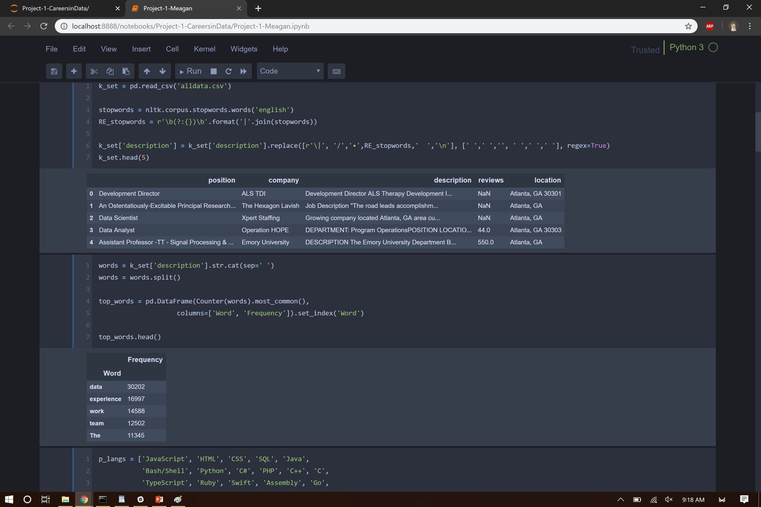
Analysis
Meagan

Slide 21
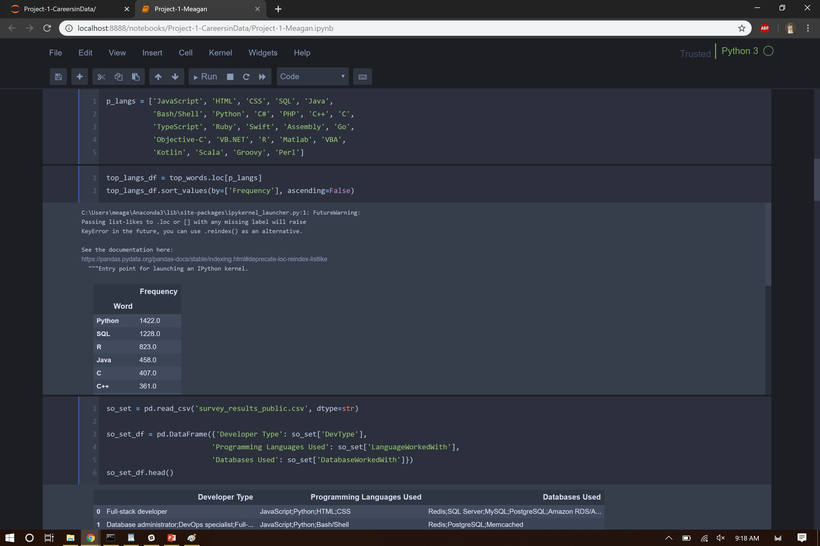
Analysis
Meagan

Slide 22
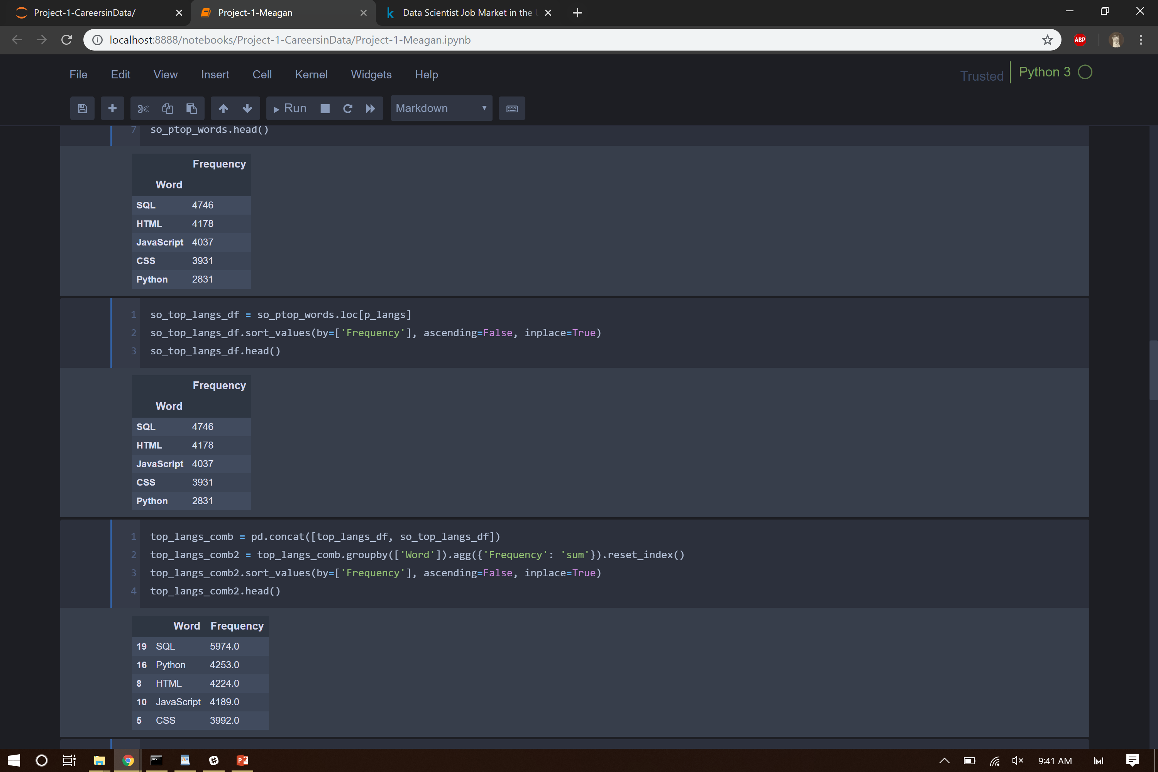
Analysis
Meagan

Slide 23
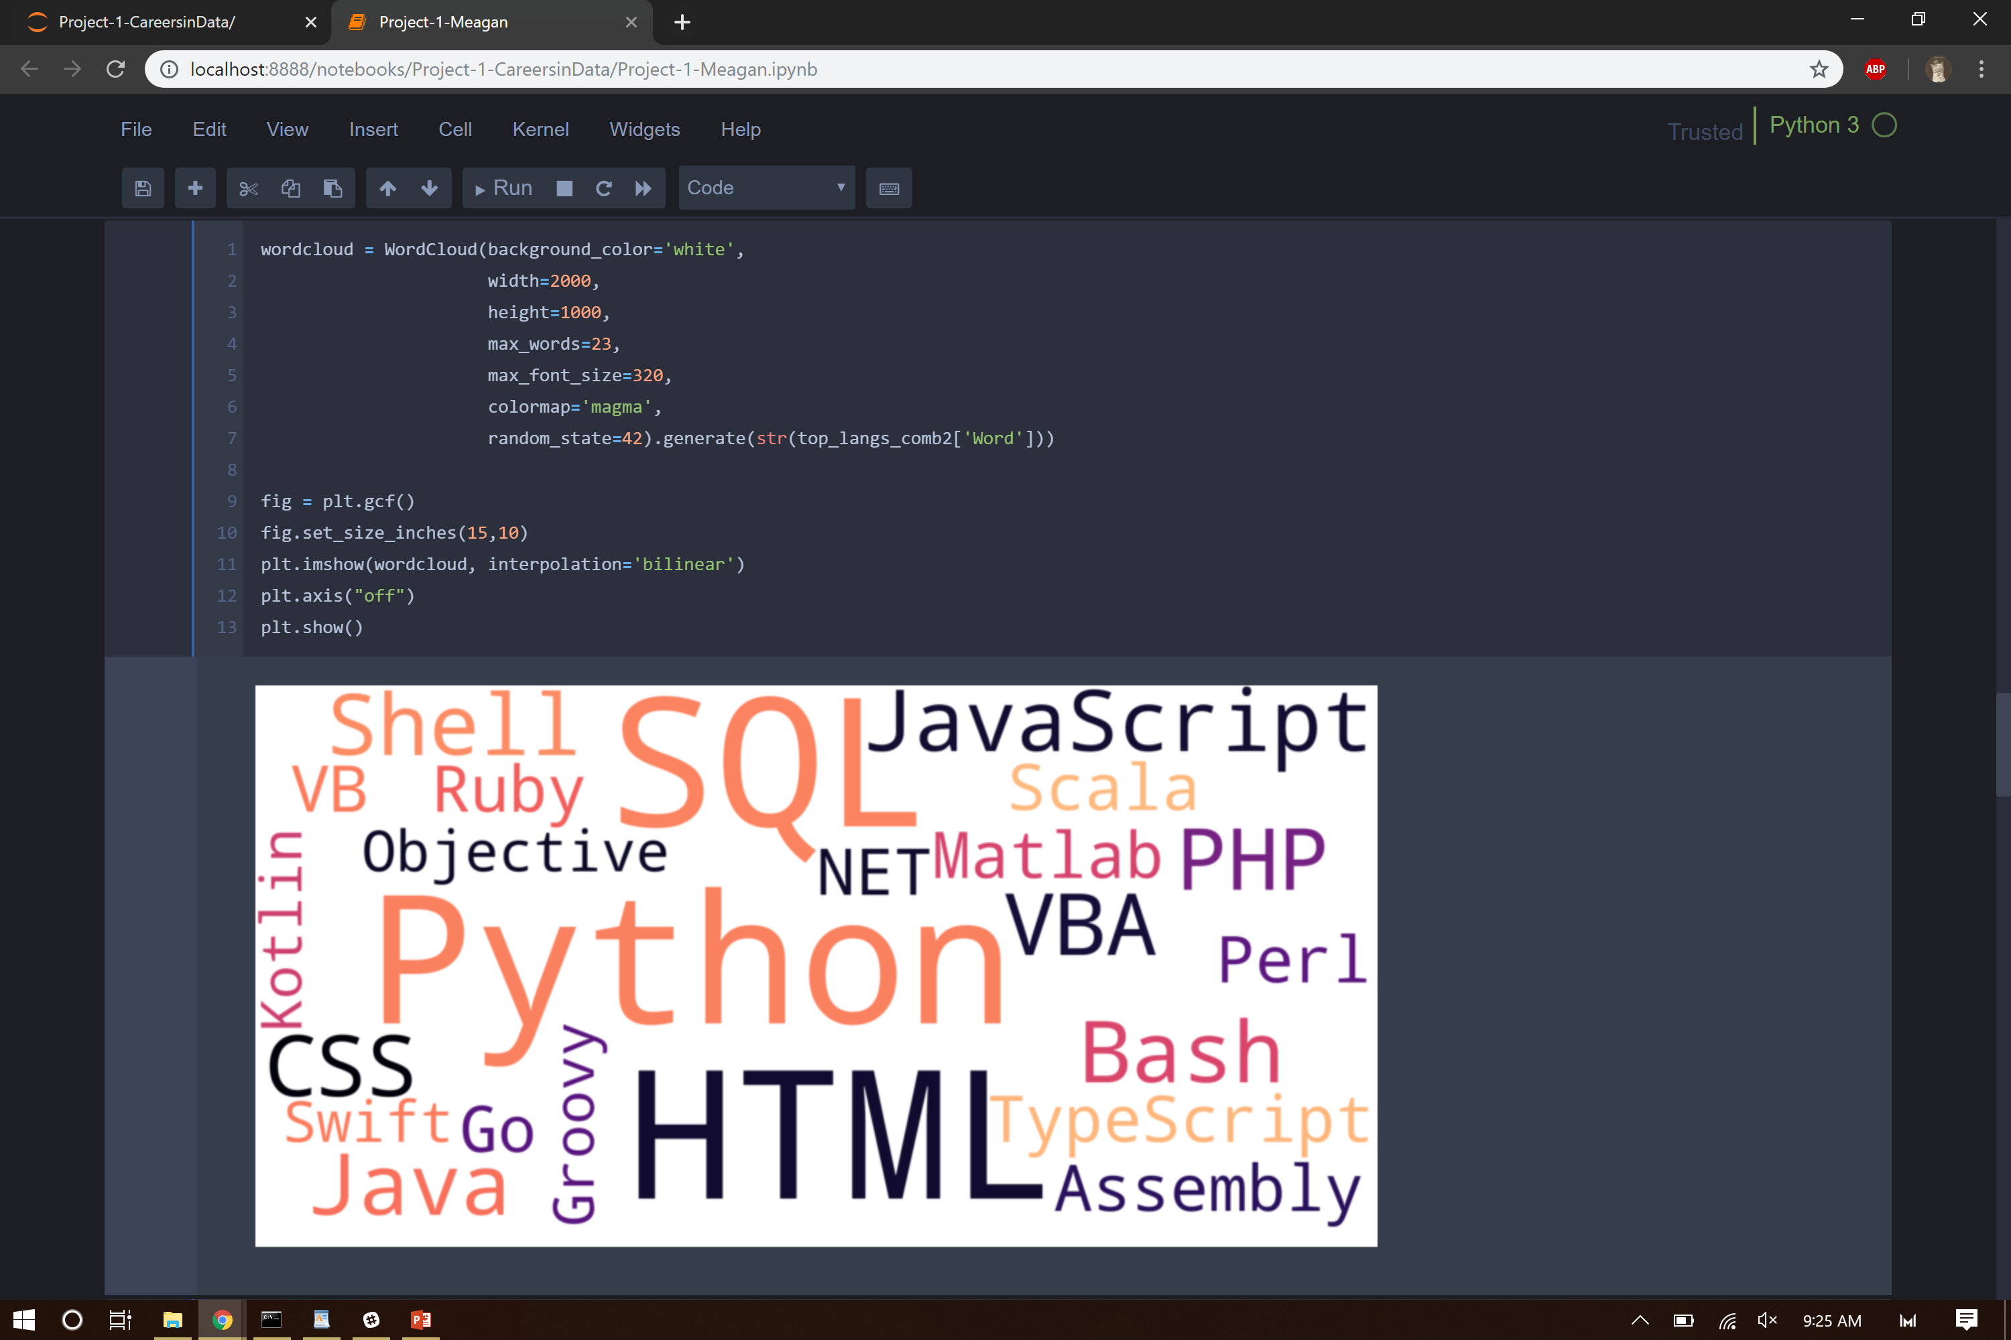
Analysis
Meagan

Slide 24
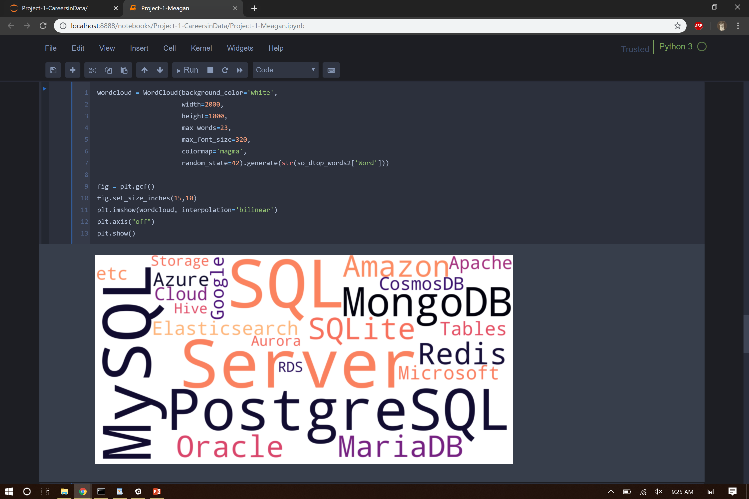
Analysis
Meagan

Slide 25
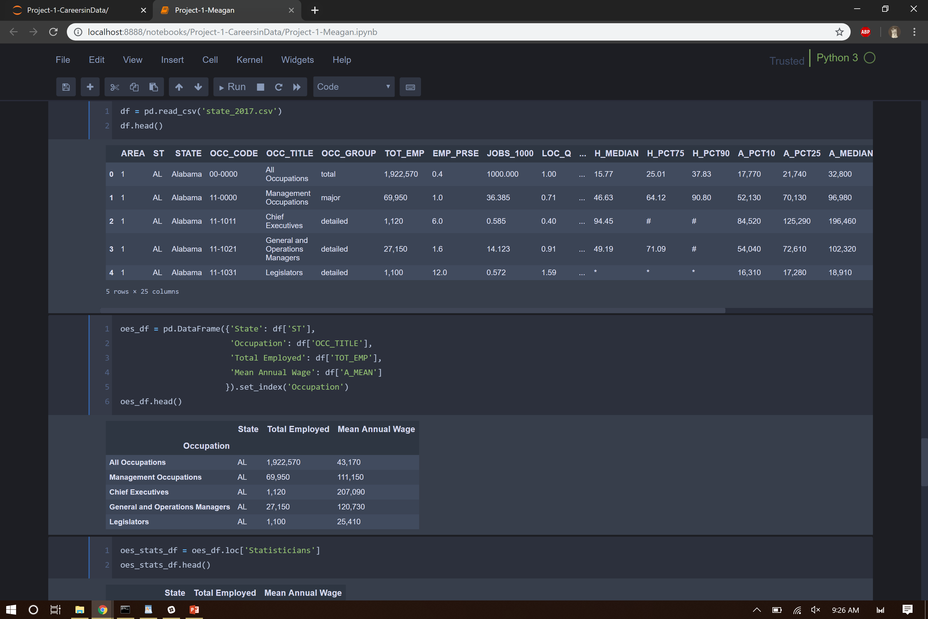
Analysis
Meagan

Slide 26
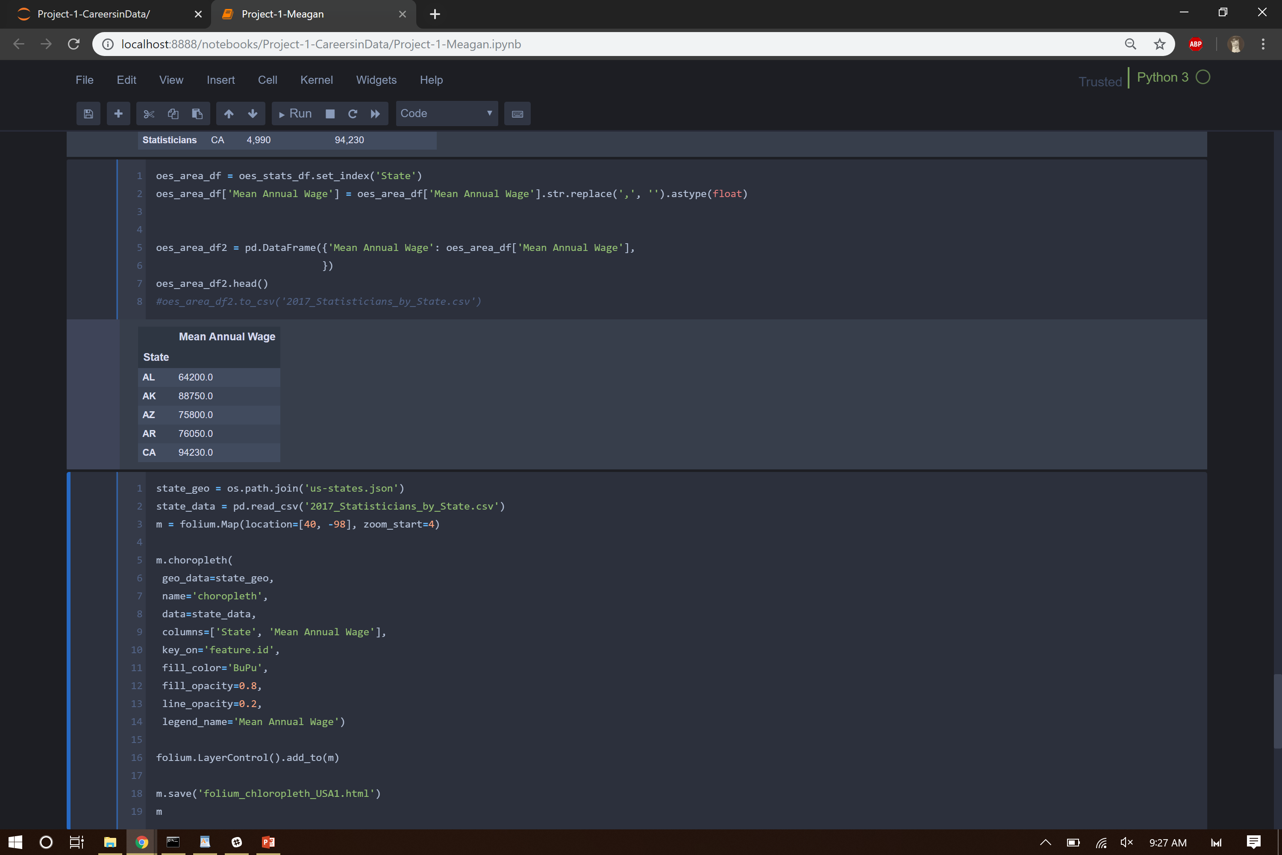
Analysis
Meagan

Slide 27
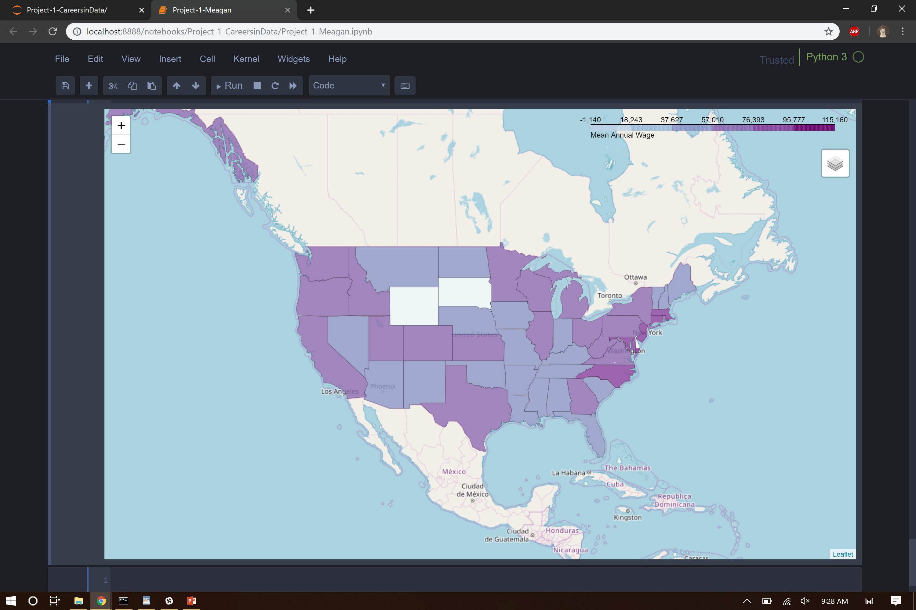
Analysis
Meagan

Slide 28
Questions
Dallas
What are the Google trends for data science versus application programming?
What are data science job satisfaction levels?

Slide 29
Exploration
Dallas
To answer the Google Trends question, I used PyTrends, which is an very easy to use, unofficial Google Trends API.
To explore Data Science job satisfaction levels, I examined the 2018 annual Stack Overflow Survey data, found on Kaggle, using Python, Pandas, etc.
Confession: I was a survey respondent

Slide 30
Analysis
Dallas
Google Trends: Graphed the search terms ‘big data’, ‘data science’, and ‘machine learning’ over a five year period. Finding: the graphs bear no resemblance – i.e., terms remarkably independent
Overall, culling the data to only self-described Data Scientists (from 98,855 to 7088 respondents), the results show a moderate level of job satisfaction (5.19 out of possible 7).
I also looked at data scientist career satisfaction (5.22 out of 7). This is compared to 5.03 (7 pt scale) to non-data scientist respondents.

Slide 31
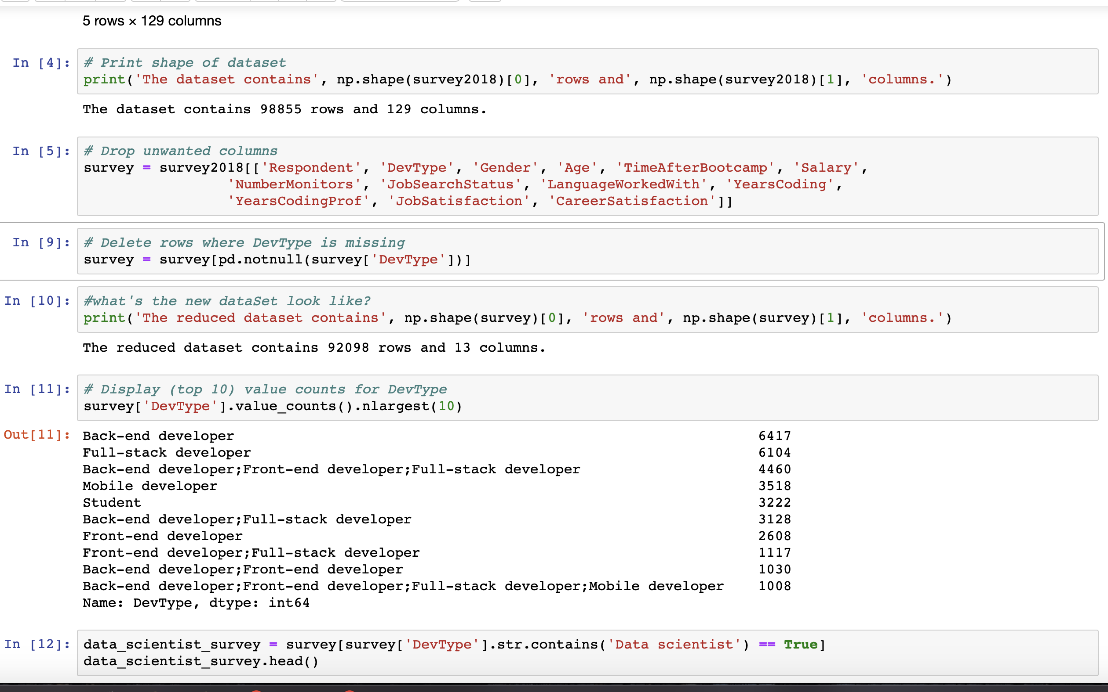
Analysis
Dallas

Slide 32
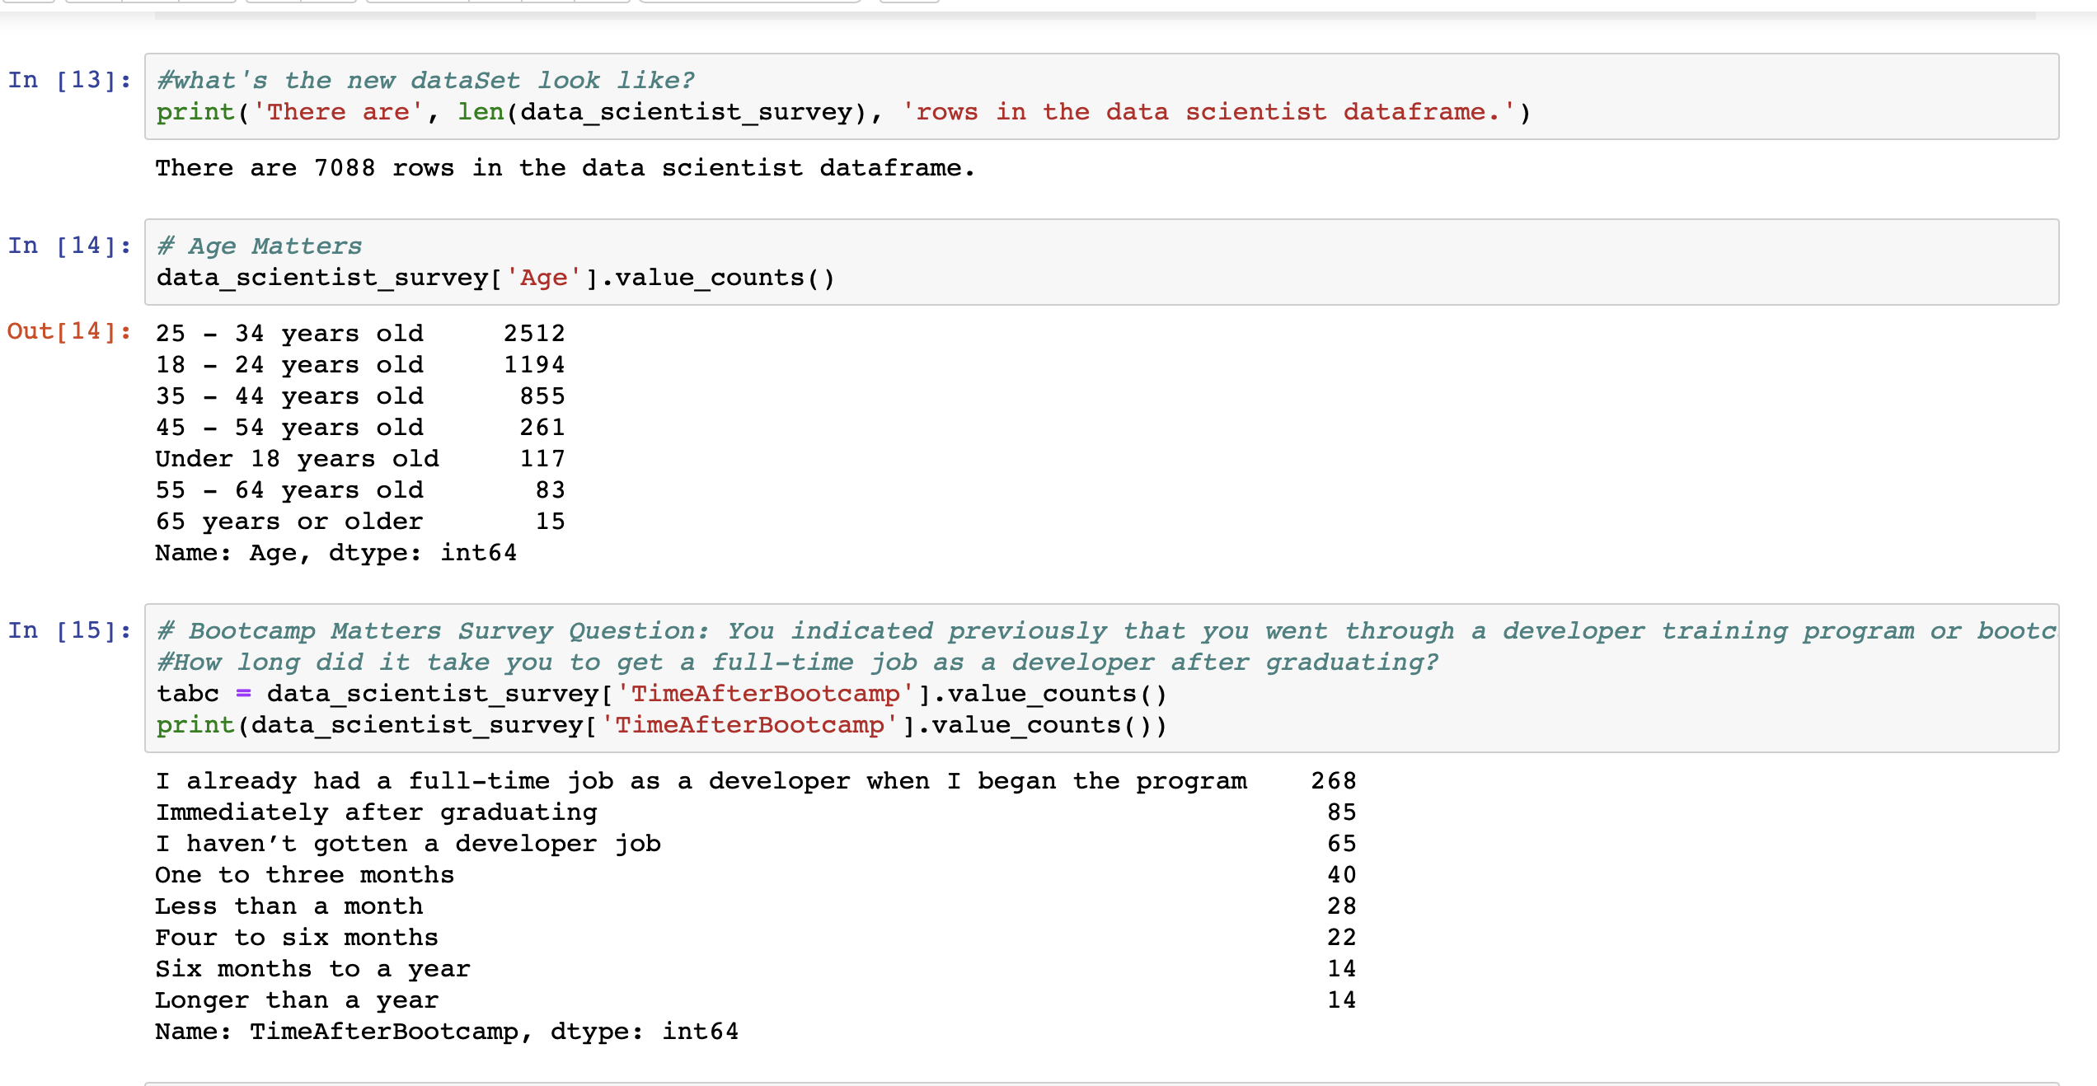
Analysis
Dallas

Slide 33
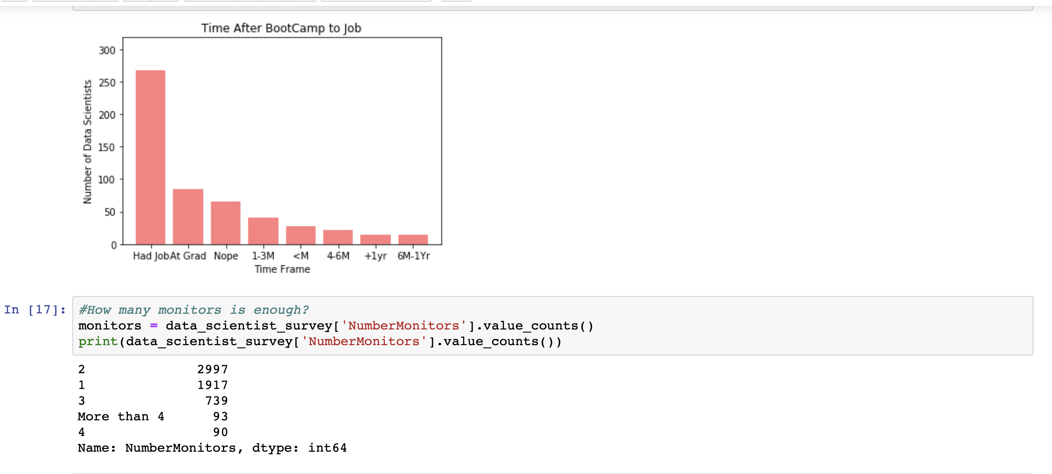
Analysis
Dallas

Slide 34
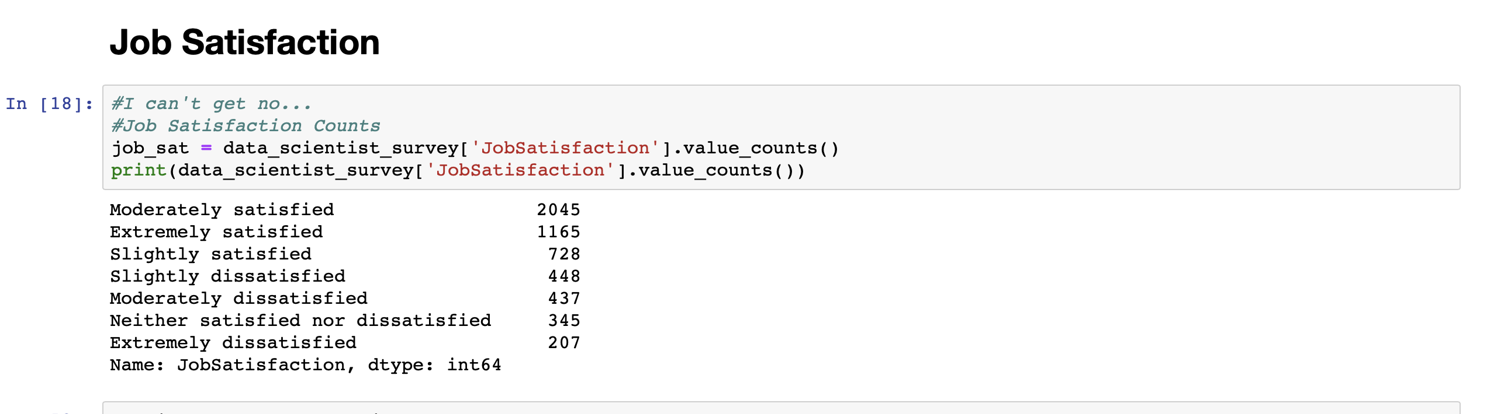
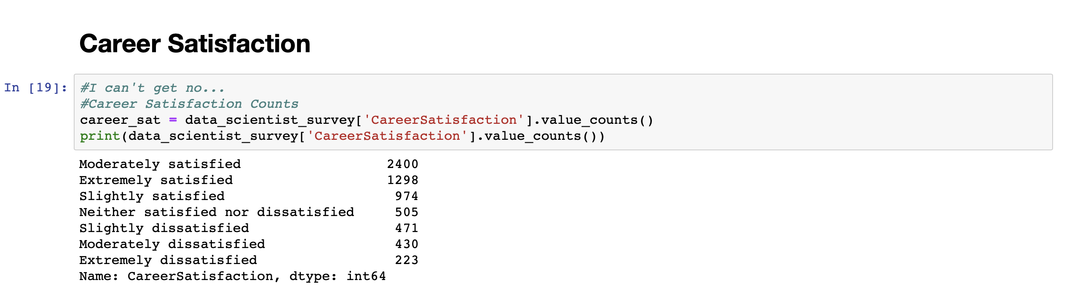
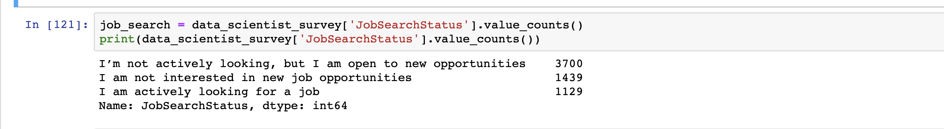
Analysis
Dallas

Slide 35
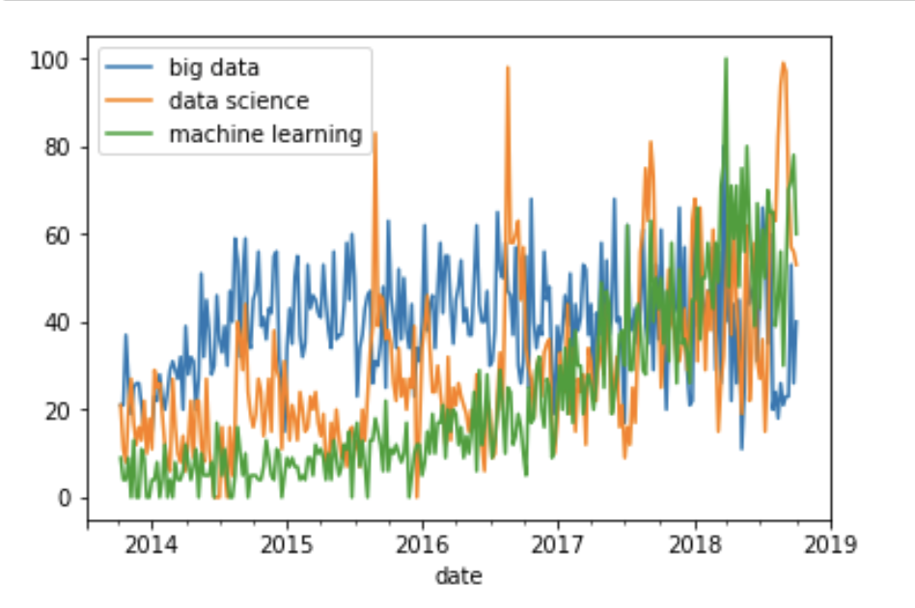
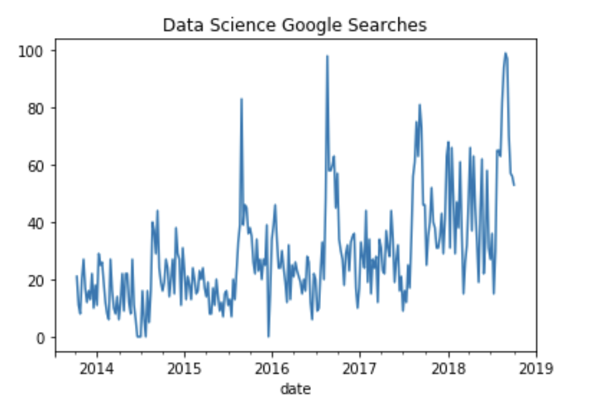
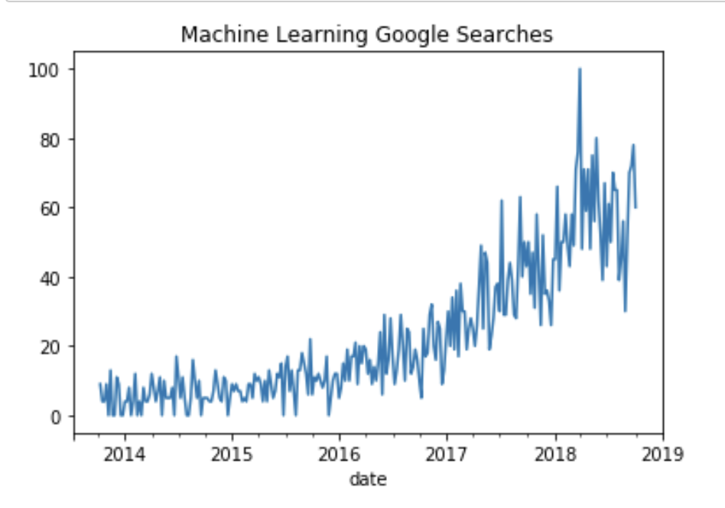
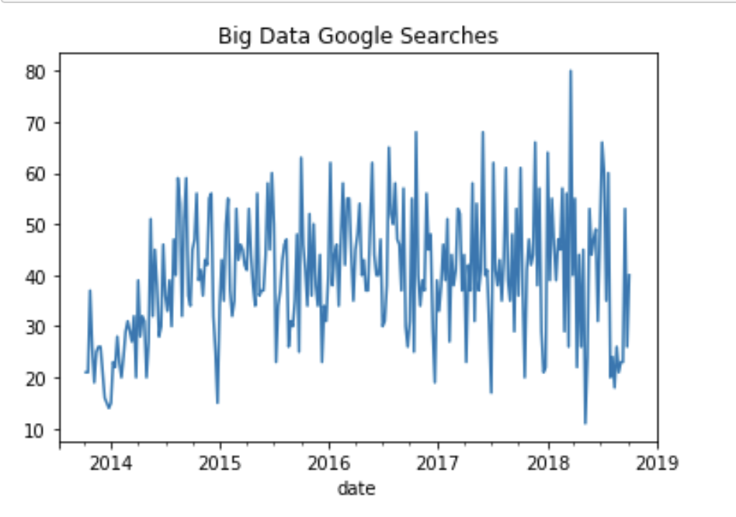
Analysis
Dallas

Slide 36
Questions?

